Slide 1
Type I and Type II errors

Slide 2


Fire Alarm Hypothesis
Lets say that you are studying in one of the rooms in CNR. Everything was normal. Suddenly you encounter a smell of smoke.
You may think:
There may be a serious fire OR could be nothing serious. May be someone burned some paper.

Slide 3
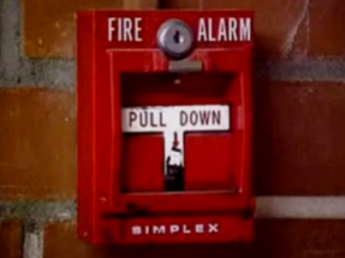
The Fire Alarm Hypothesis
If you think, nothing serious, you may decide your assumption that everything is normal so nothing is needed to be done.
(Null hypothesis: Situation is NOT serious (everything is normal))
If you think, smell is due to serious fire, you reject your assumption that everything is normal, and pull the fire alarm.

Slide 4
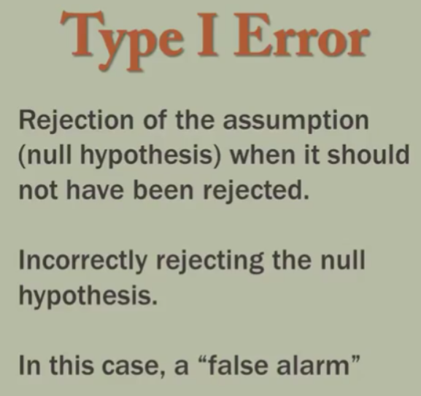
The Fire Alarm Hypothesis
You smell smoke.
You think “it is NOT normal” (reject the assumption that everything is normal). You are rejecting your null hypothesis.
Therefore, Pull the fire alarm.
People are evacuated and police arrives to investigate.
After investigation, it is determined that there was no fire. You falsely pulled the fire alarm.
When you rejected your assumption that everything was normal, when infact it really was normal. You committed TYPE I ERROR. e.g; A ‘false fire alarm’.

Slide 5
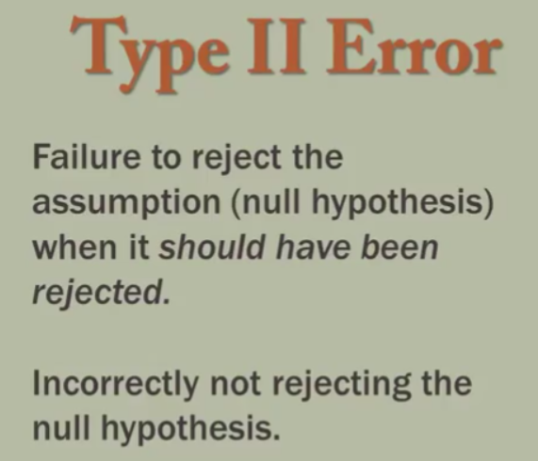
The Fire Alarm Hypothesis
You smell smoke.
You think “it is normal”. Probably just burned the trash. You are NOT rejecting your null hypothesis.
Therefore, do not pull the fire alarm.
But there is indeed a fire, no one is injured but there was a substantial loss due to fire.
When you failed to reject your assumption that everything was normal, when it really was NOT normal. The assumption in fact should have been rejected. You committed TYPE II ERROR. e.g; not pulling a fire alarm when in fact it should have been.

Slide 6
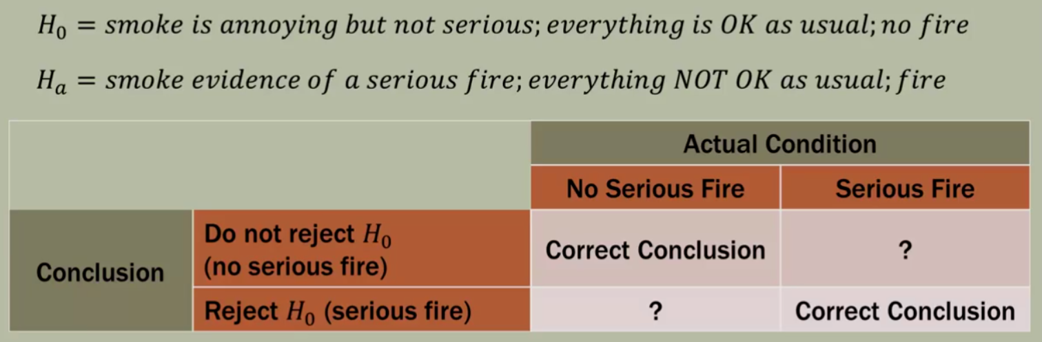
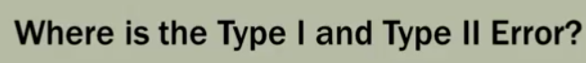
The Fire Alarm Hypothesis

Slide 7
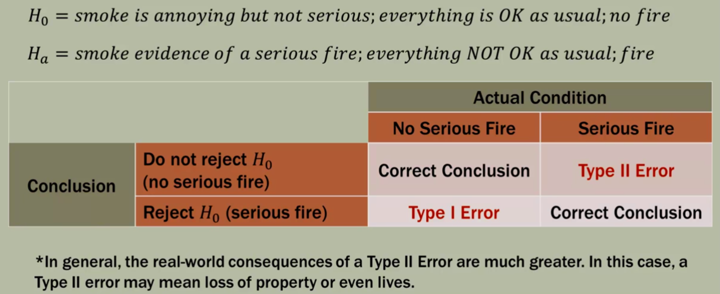
The Fire Alarm Hypothesis

Slide 8
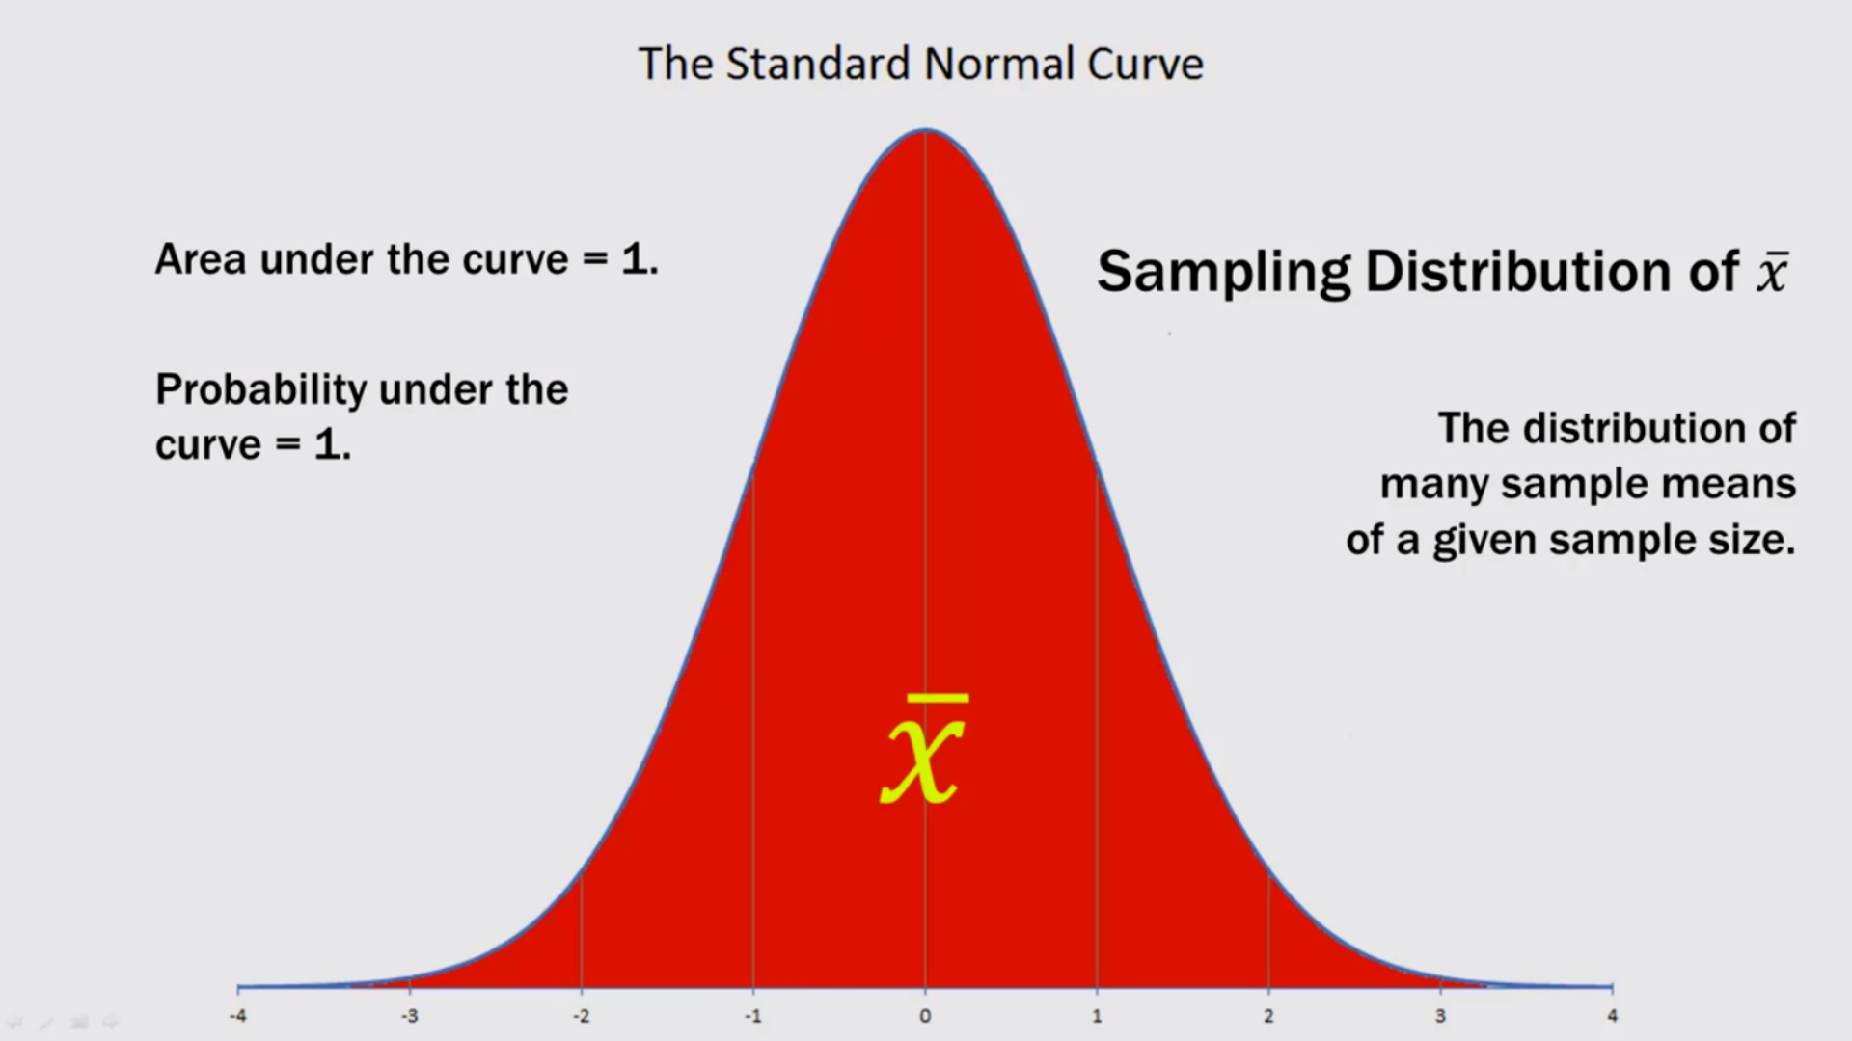
Visualizing Type I and Type II errors

Slide 9
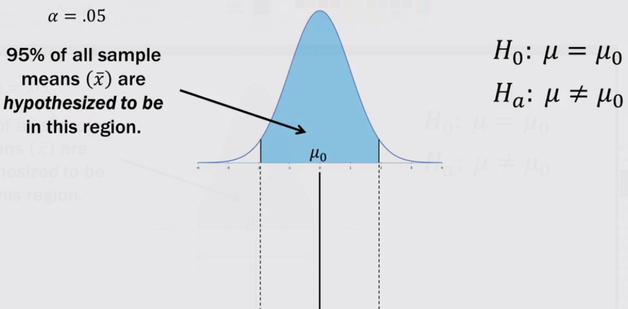

Slide 10
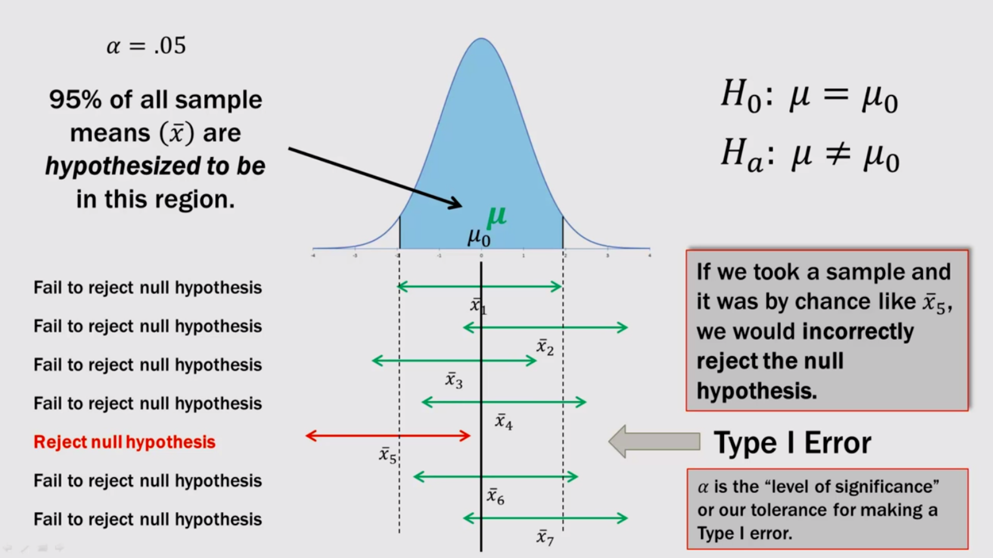
Type I Error

Slide 11
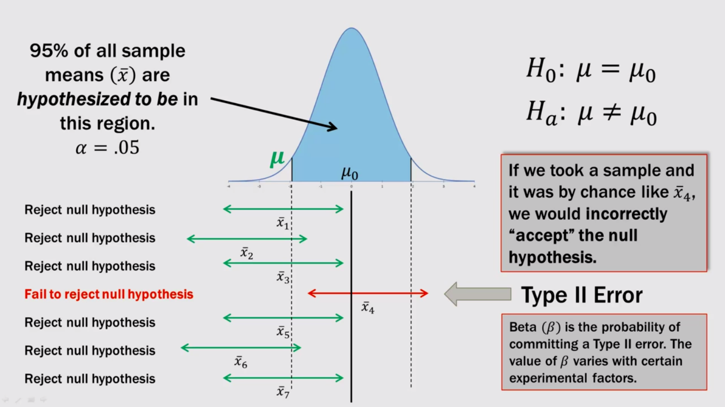
Type II Error

Slide 12
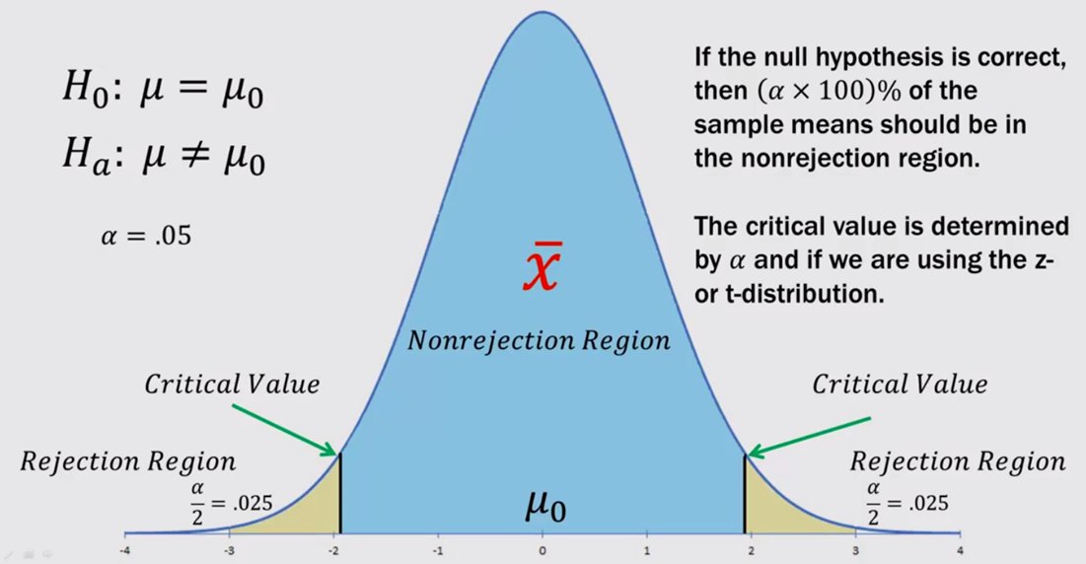
Two tailed test rejection region

Slide 13
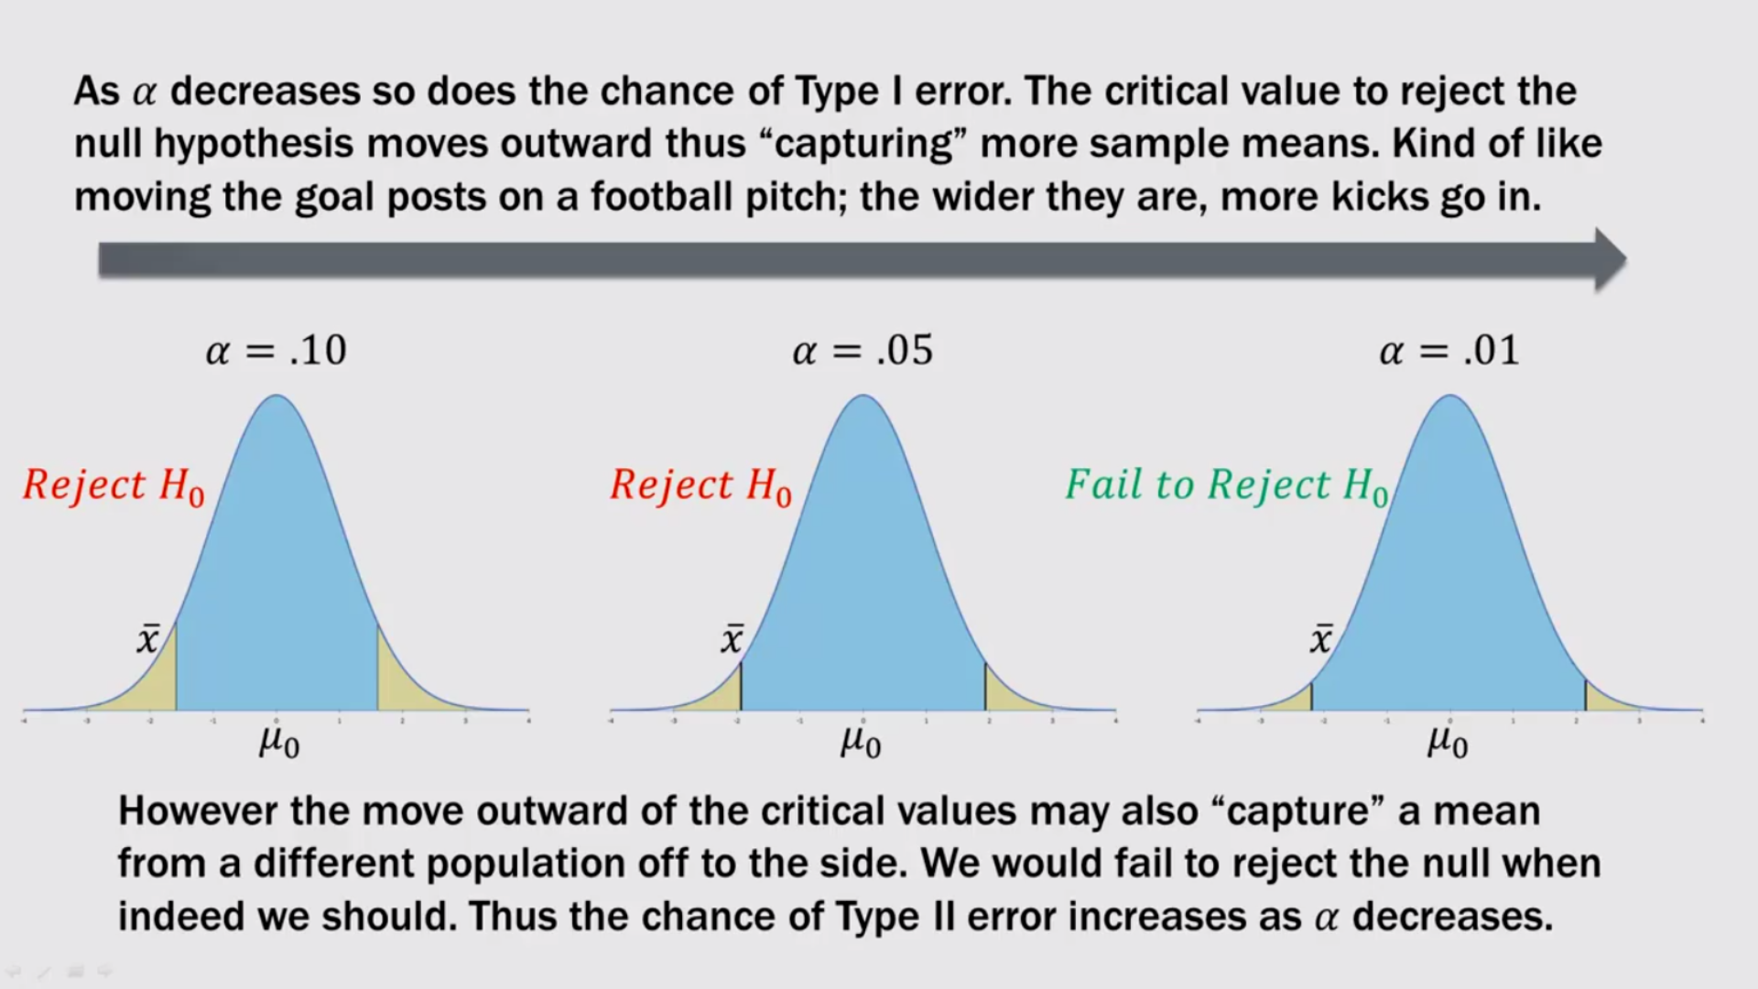

Slide 14
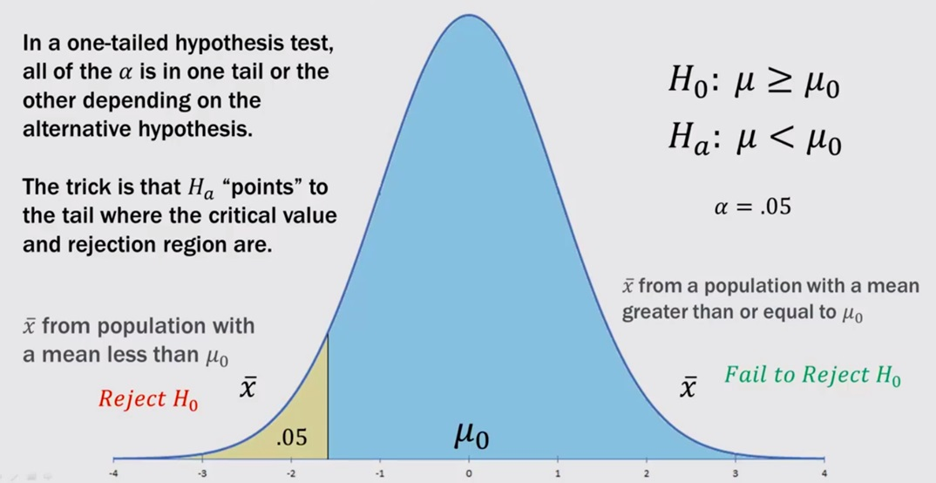
One tailed (lower) test rejection region

Slide 15
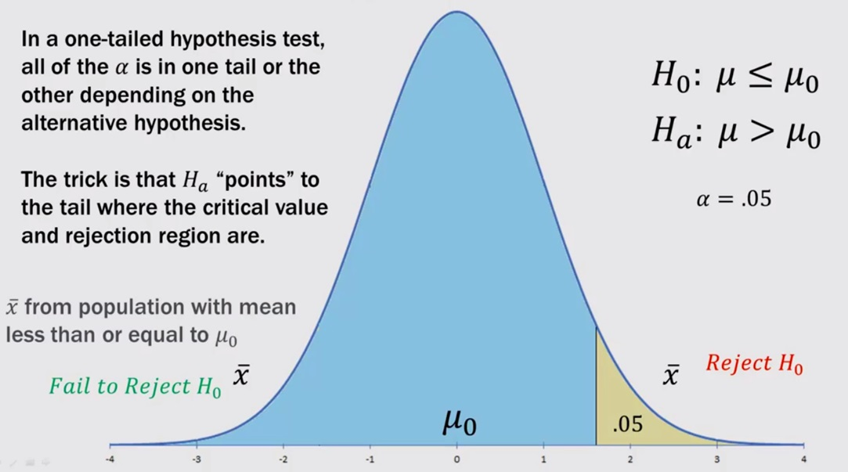
One tailed (upper ) test rejection region

Slide 16
Causes of Type I and Type II Errors
While selecting samples we are always subject to the laws of chance.
We may, by random chance, select a sample that is not representative of the population.
Sapling techniques may be flawed.
The assumptions in our null hypothesis may be flawed.
Common cause is: “chance and chance alone”.

Slide 17
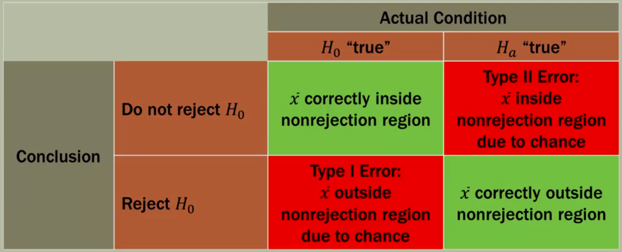
Type I and Type II Error review

Slide 18
Reference
Corty, E. W. (2006). Using and Interpreting Statistics: A Practical Text for the Health, Behavioral, and Social Sciences, Mosby Publications.
Field, A. (2008). Discovering Statistics Using SPSS. Sage publications.

